Slide 1
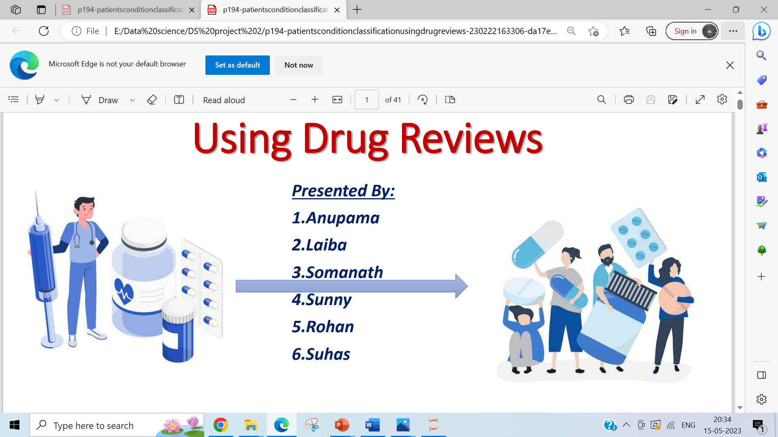
Patient’s Condition Classification using Drug Reviews
P-230 / Group # 1

Slide 2
Team Members
Vedant Ravindranath Kulkarni
Swapnil Sandeep Joshi
Aniruddha Naphad
Shivani Appaso Patil
Sarvesh Ramesh Surve
Smruti Rekha Dash
Jeripothula Saimanideep
Mentor : Madishetti Rajashekar

Slide 3
Contents
Project Objectives
Data Details
Exploratory Data Analysis
Data Visualization
Sentimental Analysis
Model Building
Model Evaluation
Model predication
Deployment

Slide 4
Project objective
This is a sample dataset which consists of 161297 drug name, condition reviews and ratings from different patients and our goal is to examine how patients are feeling using the drugs their positive and negative experiences so that we can recommend him a suitable drug.
The dataset provides patient reviews on specific drugs along with related conditions and a 10 star patient rating reflecting overall patient satisfaction
we can see many patients conditions but we will focus only on the below, classify the below conditions from the patients reviews
Depression
High Blood Pressure
Diabetes, Type 2

Slide 5
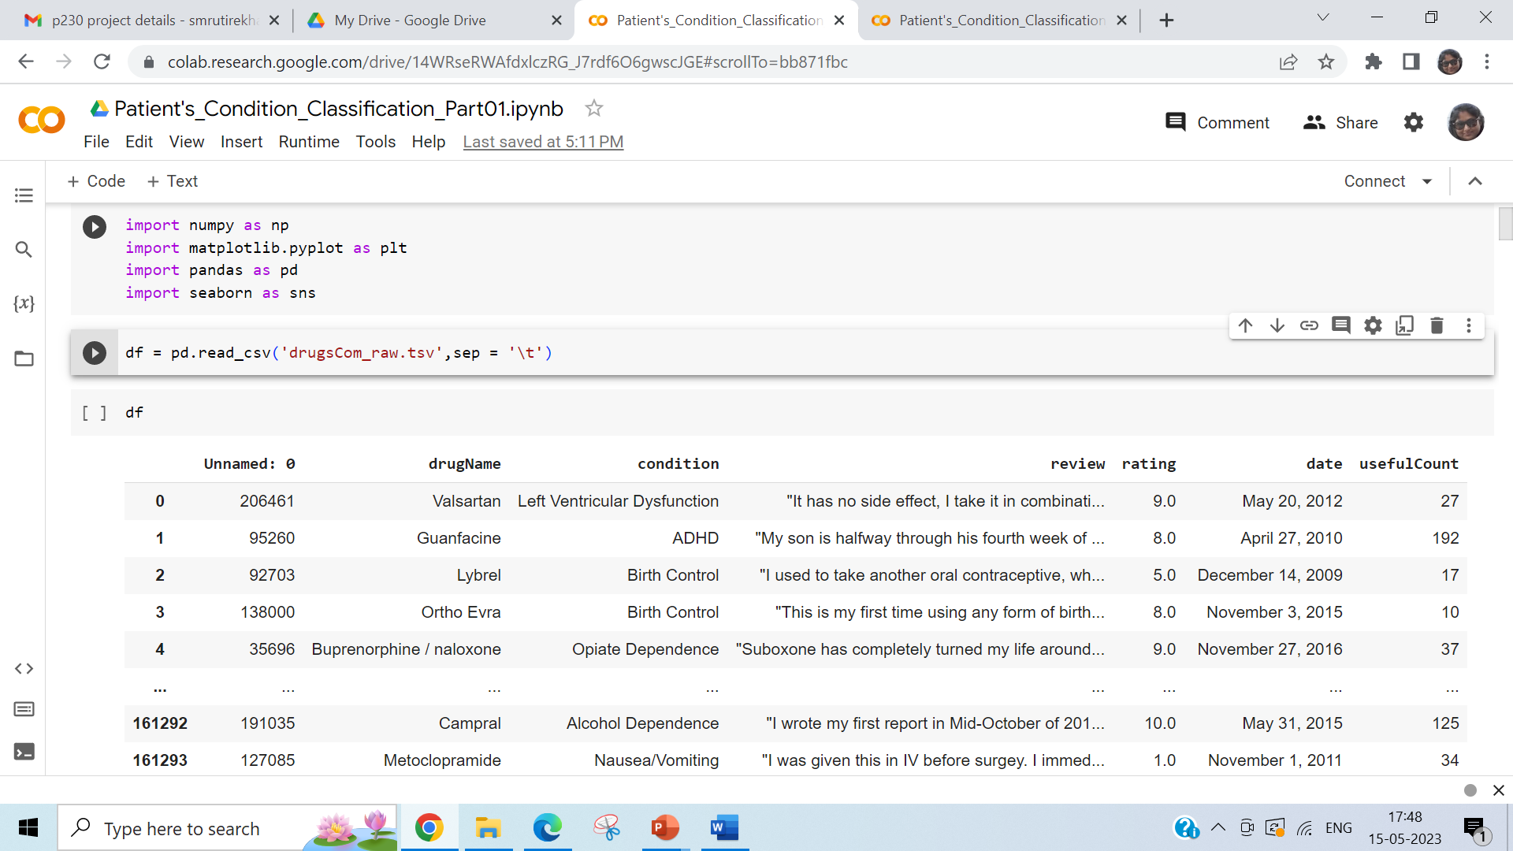
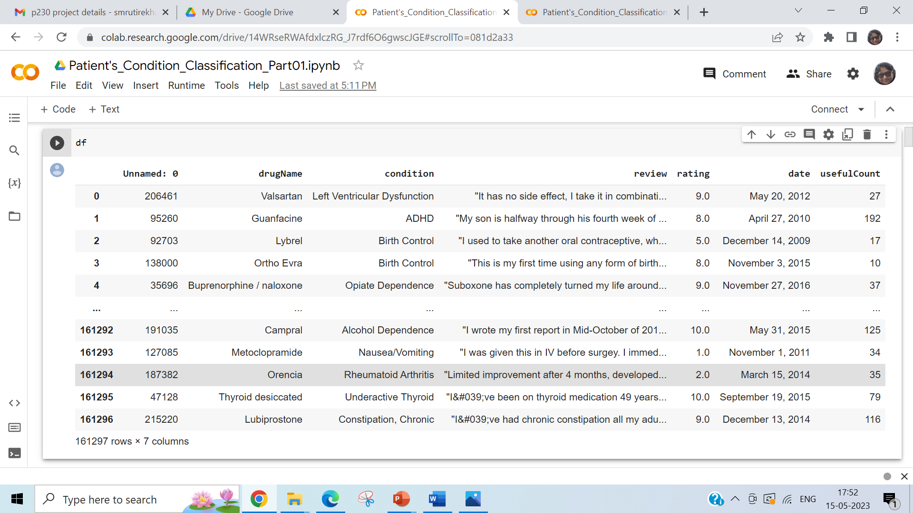
Data Set Details
Data Set Details :
drugsCom_raw (1).tsv
Attribute information
Drug Name (categorical): name of drug
condition (categorical): name of condition
review (text): patient review rating (numerical): 10 star patient rating
date (date): date of review entry
useful Count (numerical): number of users who found review useful

Slide 6
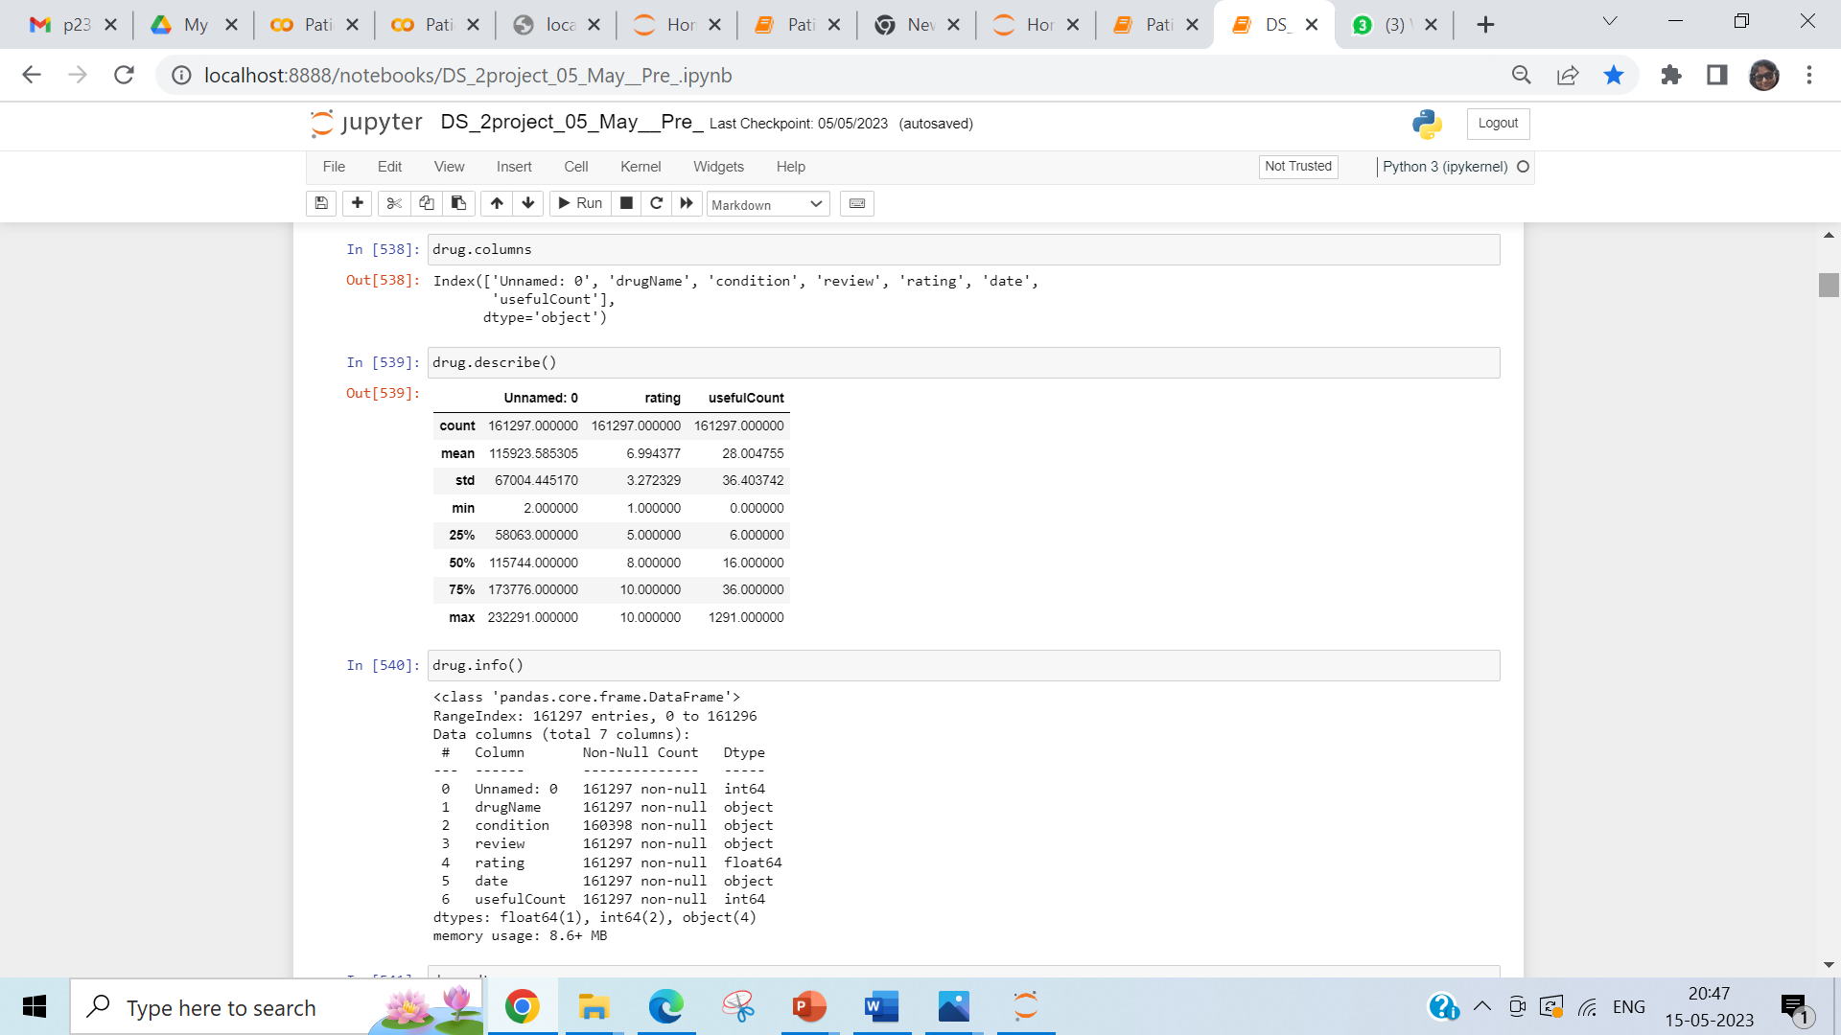
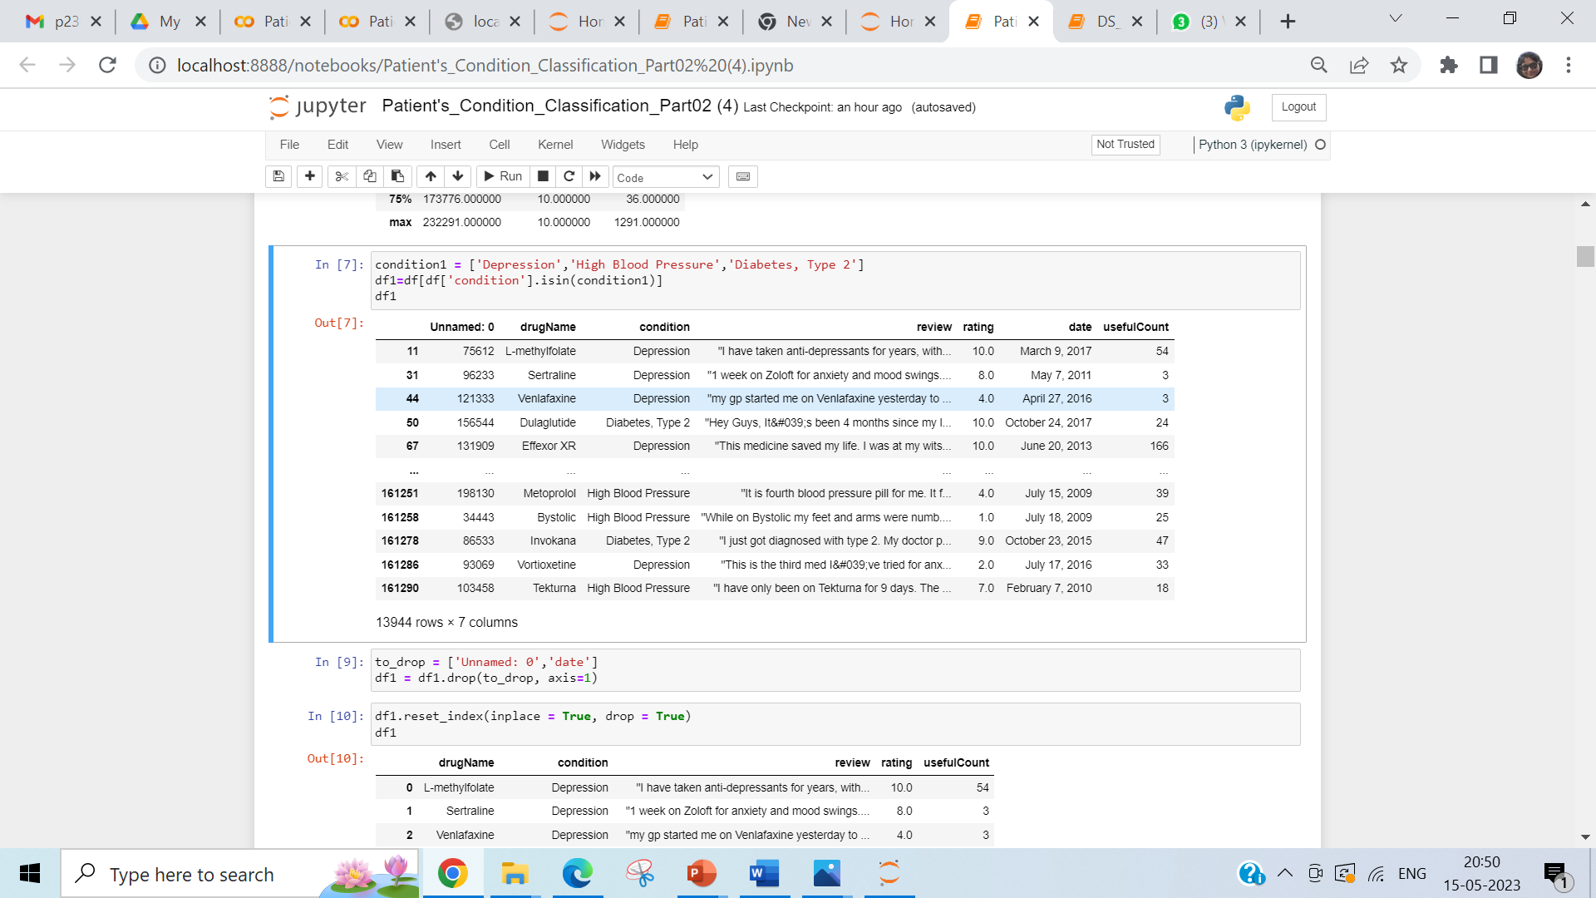
EDA

Slide 7
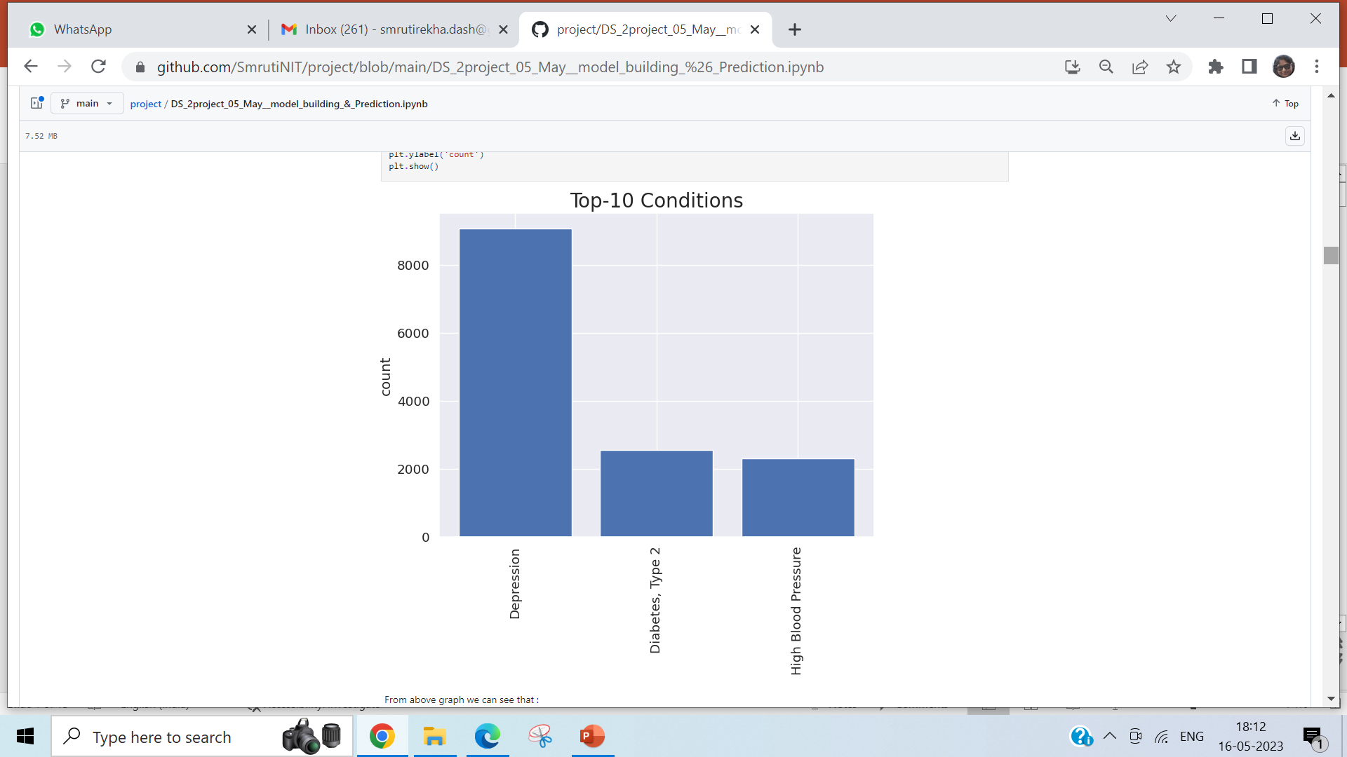
Data Visualization

Slide 8
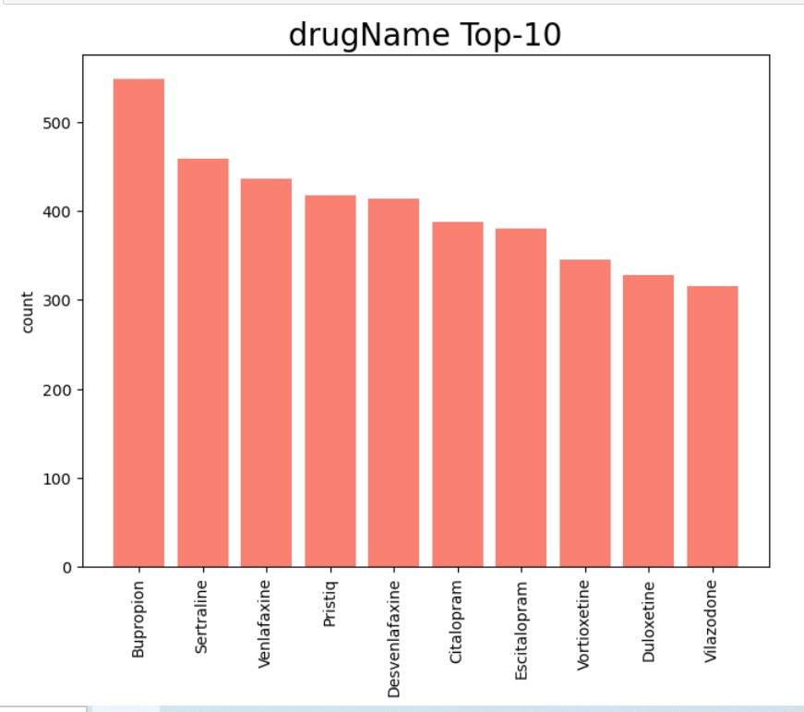
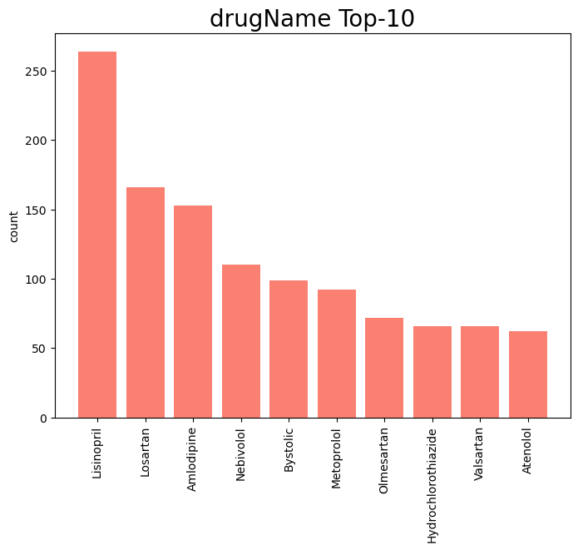
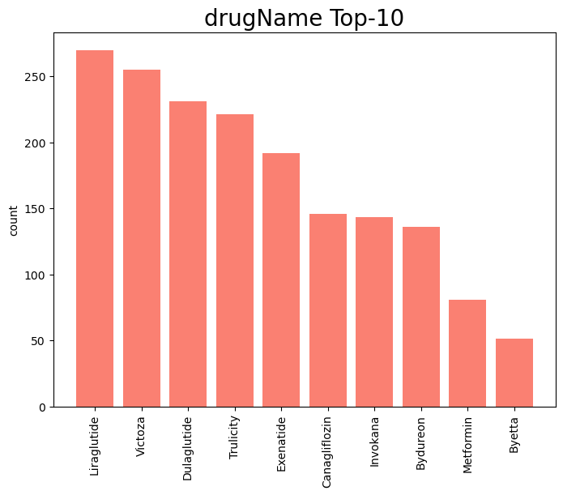
Top-10 Drug Names
Depression
High Blood Pressure
Diabetes, Type 2

Slide 9
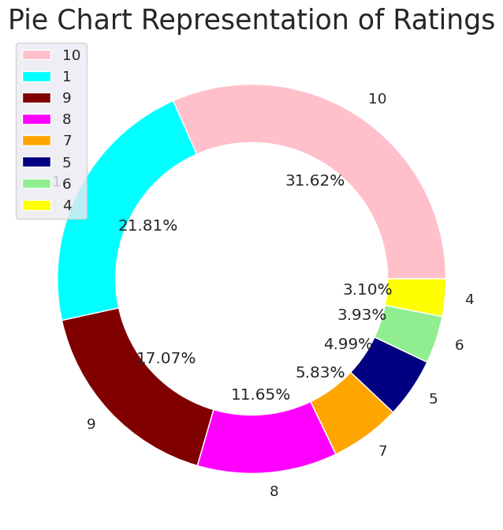
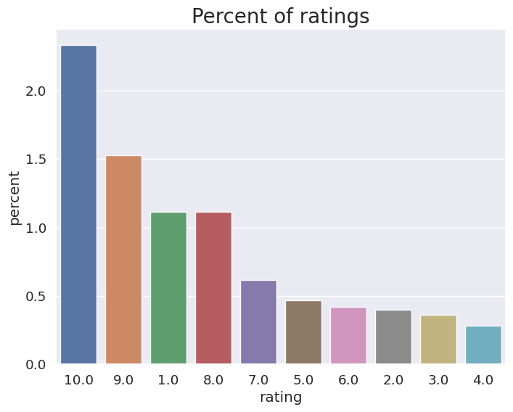

Slide 10
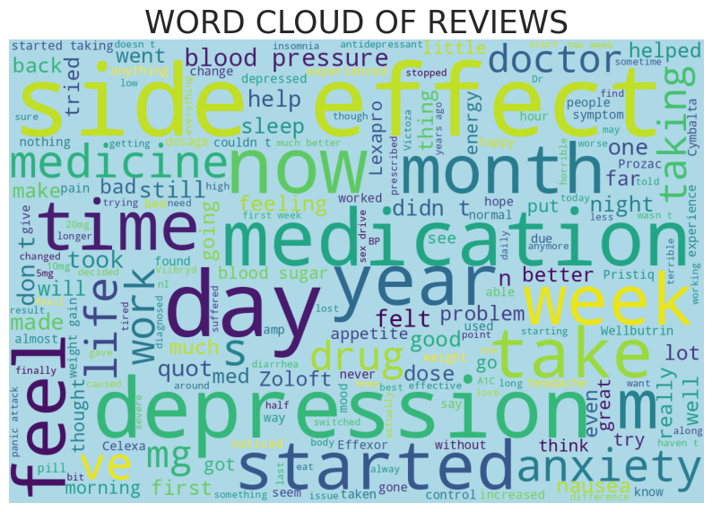

Slide 11
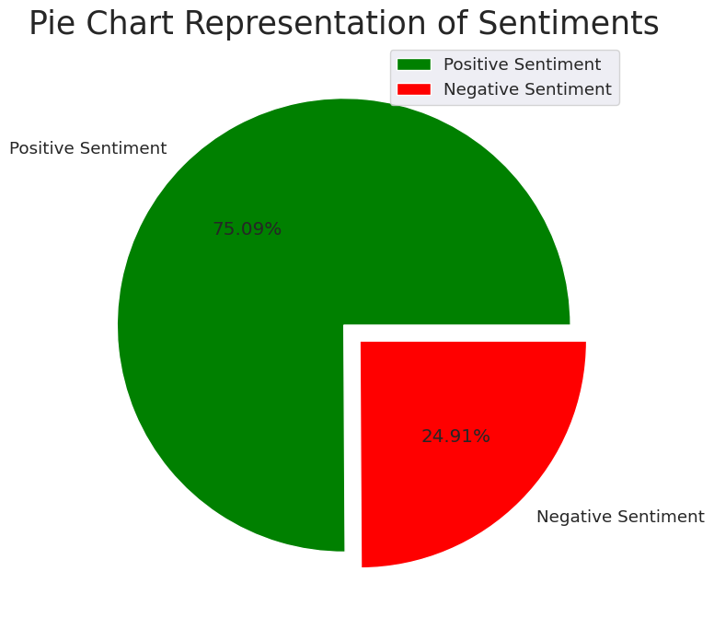
Sentimental Analysis on Reviews

Slide 12
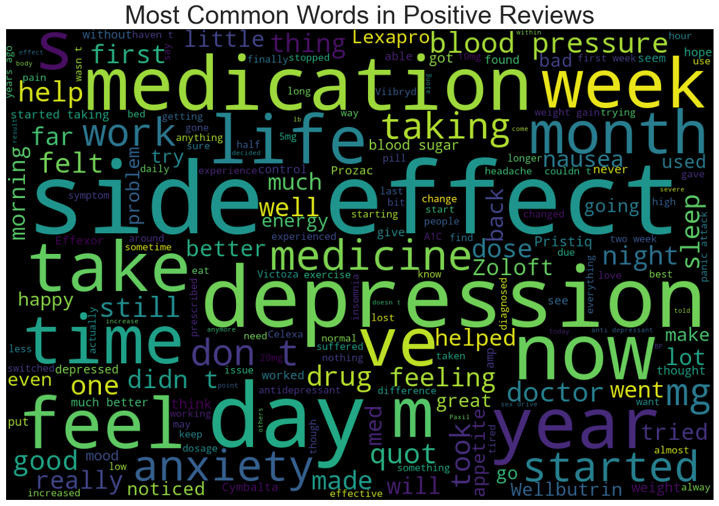
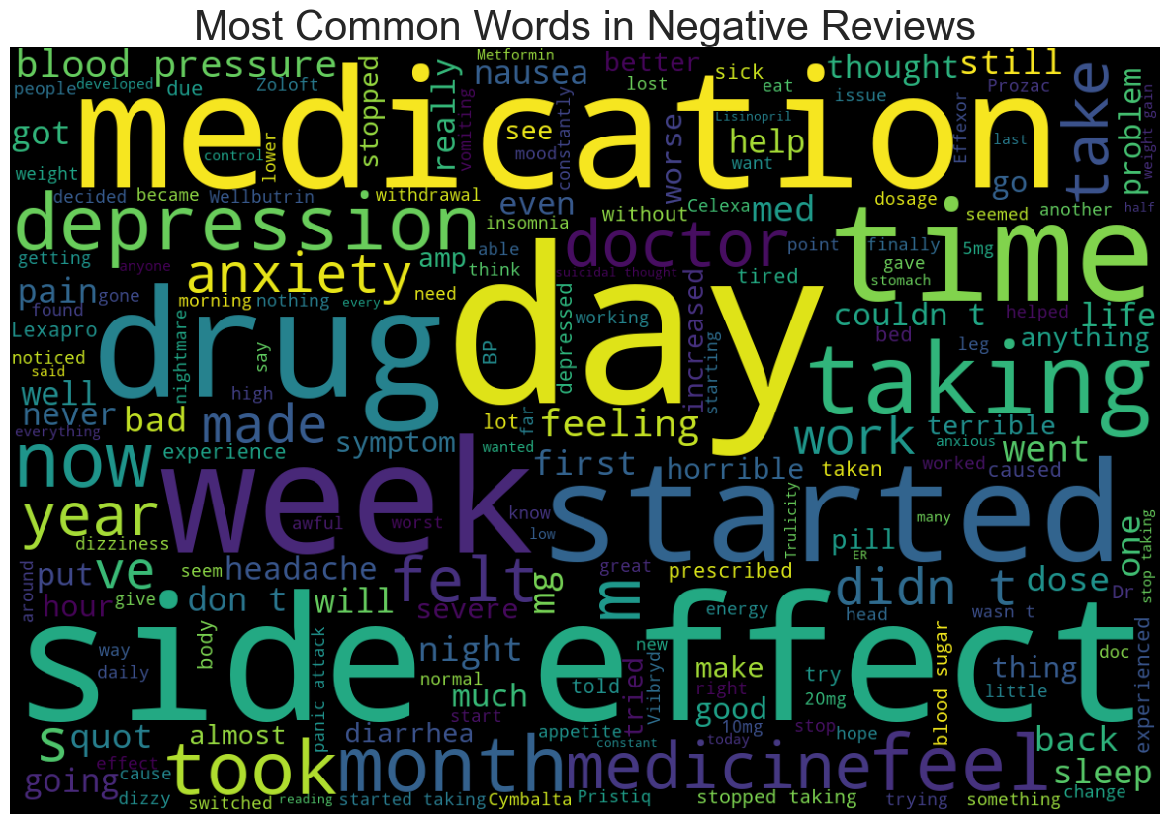
Word clouds for Positive and Negative Reviews

Slide 13
Top 3 drugs based on user review (based on sentimental Analysis)
Depression :
Trintellix Vortioxetine Duloxetine
Dibetic Type 2 :
Liraglutide Victoza Bydureon Invokana Canagliflozin
High Blood Pressure :
Amlodipine / olmesartan Azor Hydrochlorothiazide / olmesartan Lisinopril Amlodipine

Slide 14
Steps in NLP project
Tokenize the sentence
Clean the reviews
Remove punctuations
Remove special characters/numbers
Convert to lowercase
Lemmatization
Create bag of words model
Apply ML algorithms Naive Bayes and Passive Aggressive Classifier
Create TFIDF model
Apply ML algorithms Naive Bayes and Passive Aggressive Classifier
SVM
Decision Tree
Random Forest

Slide 15
Model Building
Bag of Words
TFIDF
SVM
Decision Tree
Random Forest Classifier

Slide 16
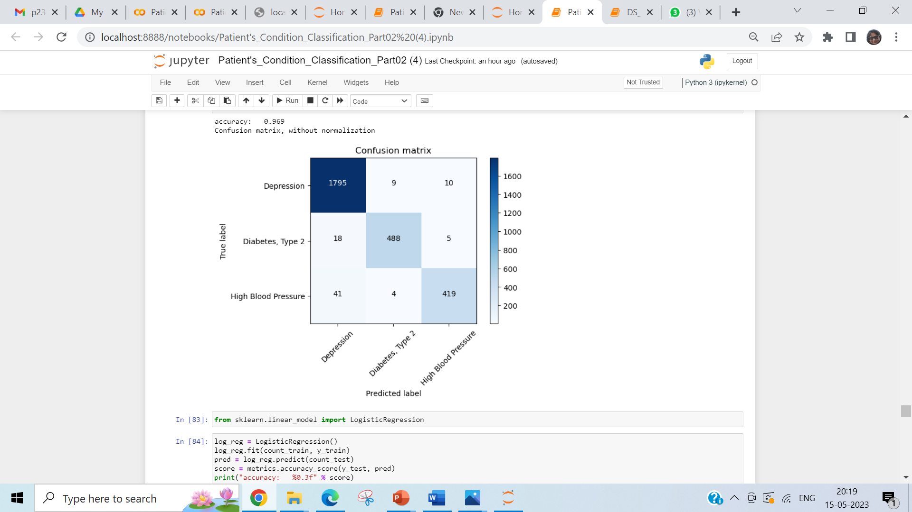
TFIDF- Trigram with Passive aggressive Classifier

Slide 17
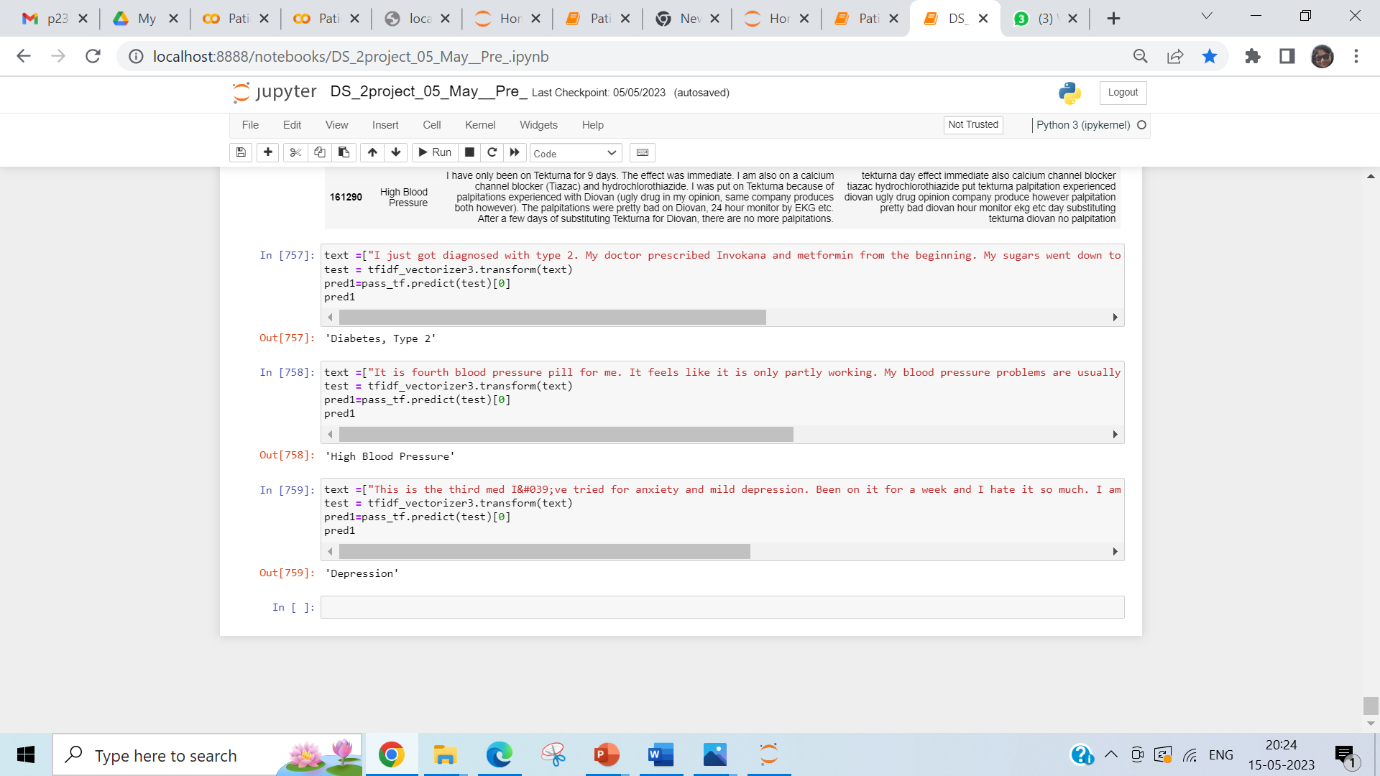
Sample Prediction

Slide 18
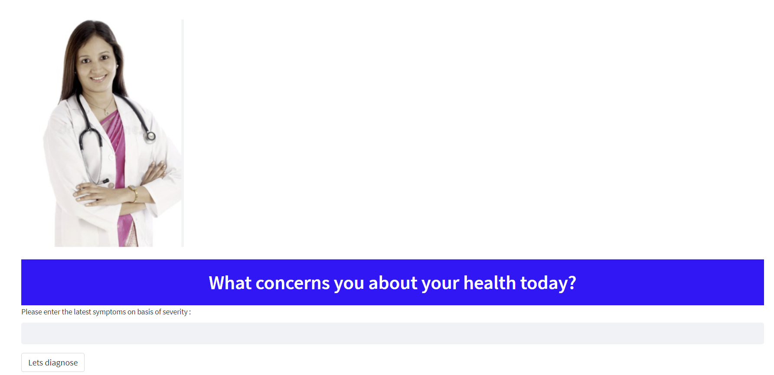
Deployment
As mentioned user have to give input symptoms based on the severity . And then need to press Lets Diagnose button

Slide 19
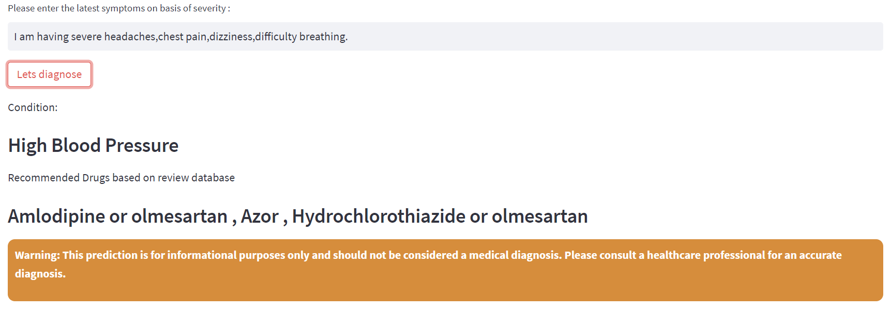
Deployment
Based on the customer input model have predicted the condition and based on the reviews it have also recommended top 3 drugs

Slide 20
Challenges Faced
Major challenges faced during execution of the project are as below
EDA and Data Cleaning
Choosing right approach to get the sort the data n order to get the top 10 drug recommendations, as data presented in huge and in text format. All the time we ned to verify manually in order to understand the working of the code.
Since data size on large size we always faced time required to process the code and understand the output with respect to the intentions. Dealing with regular expression for basic data cleaning was also a major task.
Model build and evaluation
Classification have lot of algorithms and few of them have to deal with lot of hyper parameter tunning. This time consuming process from computation front. At the end we came with algorithms which do shows higher accuracy without major hyper parameter tunning.
Deployment
This was the most complicated part in the project as this is NLP project more than one pickle file need to be extracted to get the proper output. Also mentor demanded more beatification which lead to more exploring the stem lit commands.

